Slide 1
Product Engineering JIRA Ticket Management Overview and Training
v1.7 // 26 SEP 2022
Product Engineering Leadership

Slide 2
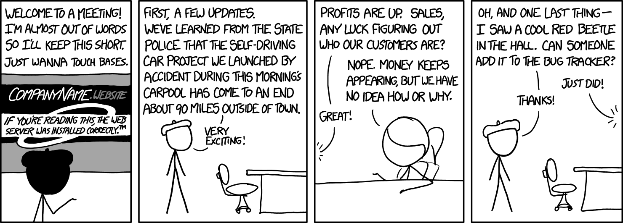
Scope // Background
Scope
Outlines a scheme for managing tasks as tracked in the JIRA ticketing system
Currently used in the following JIRA projects
BCX (9810), SFX (9770), SQM, TD8 (9523), TD2 (960x), HB (handsets), and ANC (Certus Network Controller)
Deck targeted to ticket Creators and Actioners
Normally-hidden slides for discussion with Project Leads and Software Engineering Individual Contributors
Focuses on Philosophy (why) and Practice (what) – but not so much on Mechanics (how to click buttons etc)
Background
Scheme originally developed for software on Iridium’s legacy terminals (9523, 960x, handsets, et al) starting in 2015Q4 and evolved through active use over years since
Applied to 9770 (SFX) and 9810 (BCX) software in 2020Q2 during R&D to Value Engineering transition

Slide 3
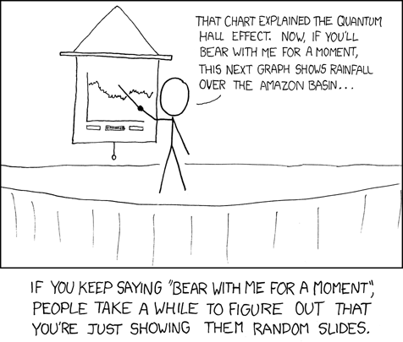
Contents // Look-Ahead
(!) Raising Tickets (2)
(!) Ticket Summary Field (2)
(!) Ticket Description Field (2)
(!) Ticket “Definition of Done” (5)
(!) Comment Threads (3)
(!) TL;DRs (2)
(!) Ticket Workflow (5)
(!) Kanban Board (1)
(!) Backlogs (5)
(?) Team Leads (1) [optional]
(?) Software Specific (3) [optional]
(!) Ticket Miscellany (2)

Slide 4
Raising Tickets // General Advice
At their core tickets are a method to efficiently and effectively **communicate** between **people**
Be Clear (precision of language prevents confusion)
Be Concise (make it easy on the reader to understand you)
Be Courteous (we are One Iridium / success requires teamwork)
Put as much effort into your ticket as you expect from others
“Throwing junk over the wall” is for n00bs
Users downstream of you (and there are a lot) will be more inclined to help - and do a better job at it - if you follow the 3Cs above
Do not raise multiple issues with 1 ticket
Tickets (and links to tickets) are cheap compared to the potential confusion
May not immediately be obvious that it’s more than one issue
Tickets forked (and linked) once this is discovered – but should not be the normal modus operandi
Adjunct guidance: Don’t pile on more “related” issues into a ticket once it’s opened (more on this later) // See “tickets are cheap” axiom above

Slide 5
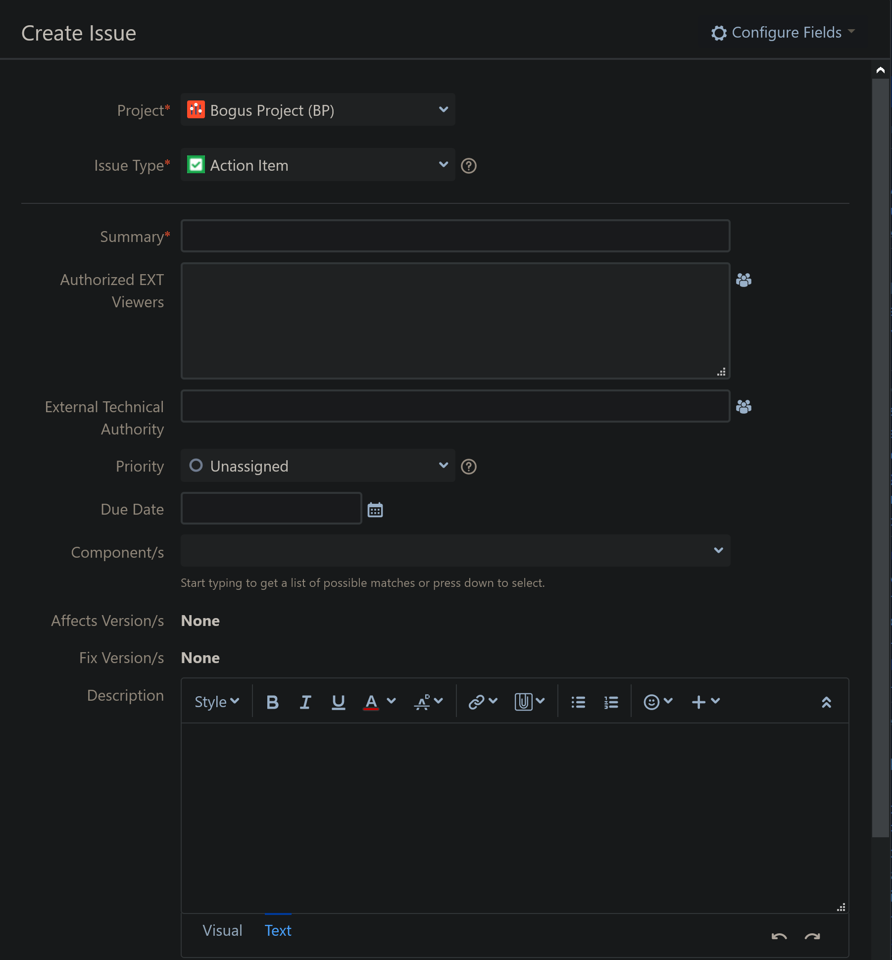
Raising Tickets // Defining Key Terms
Reason for this Conversation
Official JIRA terminology for two key fields is … potentially confusing;
Term “Summary” in isolation is reasonable to resolve to “those paragraphs at the top of the ticket”
You’d be wrong
Yes, when given choice between “Summary” and “Description” in same context you can map them
But in this presentation and in spoken conversation you seldom have both names in front of you to choose from
This presentation uses official terms – but I will likely voice-over as the more common spoken names
Summary → “Title”
Description → “Details”
Some Trivia (while we’re here)
Why did Atlassian name their product JIRA?
Hint: Issue tracker market was dominated by Bugzilla
”Title”
”Details”

Slide 6
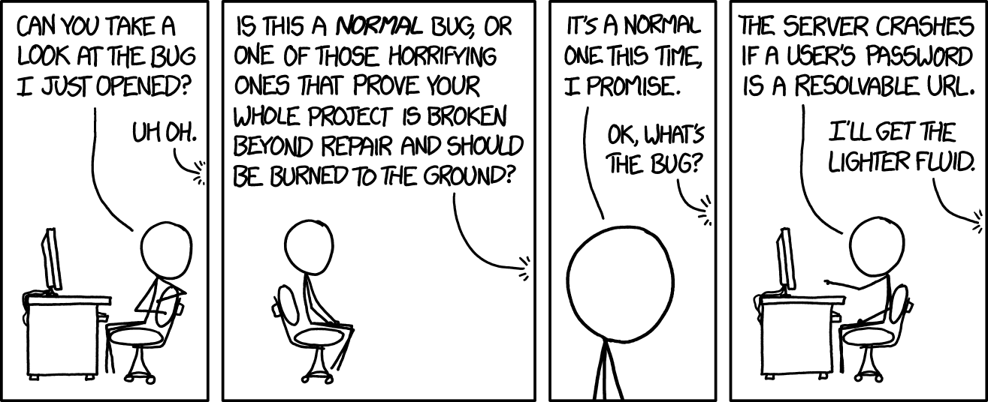
Raising Tickets // Summary Field
Ticket Summary: The “Title” of the Ticket
Ultimately how a ticket gets noticed and referenced //everywhere// - ticket lists, Kanban cards, project status decks, presentations to executives, release notes, and on and on
Words used here are gold – take your time crafting it
Include everything important ... without being //too// wordy
“Wrong Upgrade Tool Version” (poor – lots of ambiguity)
vs
“Erroneous Version Number in 960x Upgrade Tool TG17002 GUI”
Suggestion: think “newspaper headline” when writing
Put key information at front of summary
Retains key terms when truncated on board cards
Makes for faster grok when reviewing tickets
Gives easy/natural handle (in meetings you will say “Erroneous Version” and everyone will know the ticket you are speaking to)

Slide 7
Raising Tickets // Description Field (1/6)
Key Contents of an Effective Description
Reminder of the 3Cs: Clear. Concise. Courteous.
Executive Summary
One or two sentences of what the ticket is about and why it matters
Impact Assessment (e.g. Value Proposition)
One or two sentences indicating “how big a deal this is”
What is the impact if this happens in the field? How likely is that? Are we in a race to get this done before something else? What is this blocking?
Context
Any potentially relevant background
Pointers to other tickets (spawned from or blocking etc)
Details
A detailed (but concise) description of the issue or request
Avoid speculation and hyperbole!
For software or hardware “bugs”: What led up to the event and/or what are the steps to recreate? – and //all// versions of anything relevant
For investigations/scoping/general: Anything known that helps frame the ask
Definition of Done
(More detail about DoDs coming up…)

Slide 8


Raising Tickets // Description Field (2/6)
Key Contents of an Effective Description (summary from previous)
Executive Summary, Impact Assessment, Context, Details, Definition of Done
Understanding the Anatomy of an Effective Description
Ticket Purpose Reminder: Efficiently and Effectively Communicate between People
What People? – And What Are Their Needs? (And how does Description address these?)
Product Lead
Whomever is setting the priorities – e.g. ranking tickets to create a backlog of work items
What is the value and risk? // “Impact Assessment”
Technical Lead
Responsible for quality, timely, and cost-effective path from initiation to conclusion
What needs to be done? Is everything done? // “all” but also “Definition of Done”
Individual Contributor(s)
Subject matter experts who will likely do most of the heavy-lifting in the ticket
What is this about? How do I recreate? What do I need to do? // “all”
Managers and/or Observers
Anyone interested in the topic
What is this about? What is the impact? How does it relate to other stuff? How much is left? // “Exec Summary”, “Impact Assessment”, “Context”, “DoD”)

Slide 9


Raising Tickets // Description Field (3/6)
The Power of a (Live) Definition of Done
Sets the scope of the ticket/activity
Communicates to all what is to be done, has been done, is still to go
Is a quick reference point for the major points of progress / decisions
Prevents meandering (e.g. “dilute”) tickets
Sets a clear trajectory for the work from the start
Assigns //actions// to //people// (more on this in a few slides)
Advanced Level: Write in Imperative Mood (each bullet is an action)
The DoD: A Spade as A Spade
A Definition of Done is really just a bullet-point checklist in the ticket Description
Why rename it to “Definition of Done”?
Because DONE feels good. We’ve finished something. Boom. Mic drop. Now we’re on to the next task/ticket to create even more value.
“Are you done yet?” Without a Definition of Done how can we effectively communicate when this question is asked?
A Definition of Done is also defined by the Agile Alliance as a key process component

Slide 10

Raising Tickets // Description Field (4/6)
The “Live” Part of the Definition of Done Approach (1/2)
Ticket author should try to take the first stab at the DoD
Team leads (tech lead, product lead, etc) beef it up / flesh it out through ticket lifecycle
Key responsibility of leads is to add this flesh during the period that the ticket is in the backlog and make sure ticket is fully DoD-ed by the time it reaches the top of the backlog
Icons are used to indicate status
(!) Open - Needs to be done but not done yet
(?) Questionable - May or may not need to be done
(x) Skipped - Did not need to be done after all
(/) Done
Icons updated as tasks in the list are worked
Sub-bullets added with pertinent information when Done or Skipped is not self-explanatory
Especially important on Skipped // Indicates to a reader why it was decided not to be done
(… continued on next slide …)

Slide 11

Raising Tickets // Description Field (5/6)
The “Live” Part of the Definition of Done Approach (2/2)
List often evolves as work progresses
Wording may be finessed for clarity and scope may be added as required (note //not// deleted)
Scope never wholesale removed (deleted) from the Definition of Done
Instead, either use text formatting to strike-through the text and add a new sub-bullet explaining the reason for the change
Alternatively, if the item was set as an Open item (!) and we decide not to do it, just change to a Skip (x) and absolutely always add a new sub-bullet
If the DoD is iterated heavily through the life of the ticket (it happens – but not often) it can become very messy with lots of strike through. In this case cut and paste old version into a comment, say something along the lines of “The previous DoD is no longer appropriate. Archiving previous one as follows;”, and then replace with cleaned version in description.
Are we “DONE” yet?
The ticket is ready for closure if and only if;
All items must be either or
No or items are acceptable

Slide 12
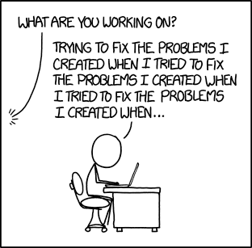
Raising Tickets // Description Field (6/6)
Pro-Level Definitions of Done – the Individual Assignment
Often DoD items are best done by a specific person
… or team, or location, or company
In these cases there is a markup pattern to note the “assignment” directly in the DoD
If this is desired the DoD should include a square-brackets prefix;
[UPPERCASE INITIALS] for a //person//
[lowercase reference] for a team, location, company
[all] for “everyone”
Examples;
[JD] Update the ICD
[sv_sw] Report on algorithm for SV power control loop
[tsc] Set up test environment
[irdm] Initiate sequence to benefit all mankind

Slide 13

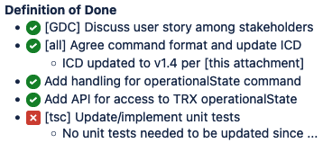

Definition of Done Example
Initial Creation (absolute minimum)
*Definition of Done*
* (!) <DoD to be created>
Ticket Being Worked
*Definition of Done*
* (/) [GC] Discuss user story among stakeholders
* (/) [all] Agree command format and update ICD
** ICD updated to v1.4 per [this attachment]
* (!) Add handling for operationalState command
* (!) Add API for access to TRX operationalState
* (?) [tsc] Update/implement unit tests
Final DoD (when ticket is closed)
*Definition of Done*
* (/) [GC] Discuss user story among stakeholders
* (/) [all] Agree command format and update ICD
** ICD updated to v1.4 per [this attachment]
* (/) Add handling for operationalState command
* (/) Add API for access to TRX operationalState
* (x) [tsc] Update/implement unit tests
** No unit tests needed to be updated since none of the internal libraries needed to change.

Slide 14



Raising Tickets // Imperative Mood (Advanced Topic)
Ticket Summary and DoD Bullets should be in imperative mood // “a Call to Action”
Definition: “The imperative mood is a grammatical mood that forms a command or request.”
(I had to look it up too.)
Example: “Update SSDI Table” vs “Consider Updating SSDI Table”
If a ticket with the title “Update SSDI Table” is DONE it is clear what the decision was – we updated the Updated the SSDI Table
If a ticket with the tile “Consider Updating…” is DONE the conclusion is unclear – Did we choose not to consider it? Or did we consider it and decide not to do it? Or did we consider it and do something else?
(Similar logic applies to a REJECT-ed ticket.)

Slide 15

Our Journey to Enlightenment
(/) Raising Tickets (2)
(/) Ticket Summary Field (2)
(/) Ticket Description Field (2)
(/) Ticket “Definition of Done” (5)
(!) Comment Threads (3)
(!) TL;DRs (2)
(!) Ticket Workflow (5)
(!) Kanban Board (1)
(!) Backlogs (5)
(?) Team Leads (1) [optional]
(?) Software Specific (3) [optional]
(!) Ticket Miscellany (2)

Slide 16
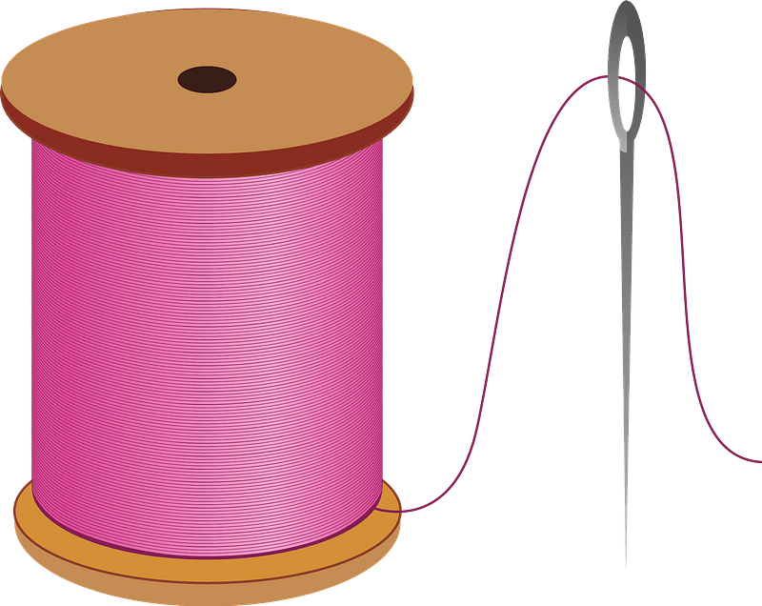
Ticket Comment Threads (1/3)
Comment thread in ticket is for...
Questions, answers, and reasons for decisions made
Succinct findings summaries
Milestone updates (e.g. communicate status)
TL;DR (more on this later)
Comment thread in ticket is //not// for…
Cut/paste logs, paragraphs upon paragraphs of content, etc
Frequent comments help Kanban board show state of work
Updates every 2 to 3 days may be appropriate for most tickets
If you are 100% on a project then try to keep tickets “green” or at worst case “yellow” as a course of habit (more about colors and where they are seen later)
Even one-line comments are a very useful update – doesn’t have to be a major breakthrough (but not just “Still in progress.”)
Comment discussions may seed tangential work
Fork new work into a separate ticket
(and do not carry-on talking about the forked issue in original thread)

Slide 17


Ticket Comment Threads (2/3)
Comment Best-Practices (ditto for Descriptions)
Include a link to any attachments in the comment
Don’t just say “the stuff is attached” (Which one of the 10 attachments?)
“See document v2.1” is also bad (someone may attach a different file with the same “v”)
Use bullet points to make your content easily grok-able
Include logs and source snippets over ~10 lines as attachments - not in comment body
Use formatting (emphasis and code markup) to improve readability
Use link syntax instead of relying on URL auto-linking
“... the document at this link” vs “... the document at https://www.google.com/search?source=hp&ei=jIFzX-brNLqyytMPqrCZyAw&q=long+url&oq=long+url&gs_lcp=CgZwc3ktYWIQAQFhAeMgYIABAWEB4yBggAEBYSQHjIGCAAQFhAeOg4IABDq&uact=5”
Do not cut/paste contents from emails verbatim
Attach PDF or distill/linearize to highlight important bits and remove cruft
Use proper grammar, spelling, capitalization, and periods
Proof-read your comment before clicking “submit”!

Slide 18


Ticket Comment Threads (3/3)
Done Means Done
Once a ticket is closed (“Complete”) no further //technical conversation// should happen on it
The only comment that should be added is the “Verification” comment (along the lines of “Feature has been verified. Test data is available here.”)
If there is more to discuss then a new ticket needs to be opened (and mention in description the relationship to other ticket and link using JIRA ticket linking feature)
Comment Threads //are not// Email Threads
Email typically directed at single person (with others on copy as FYI)
JIRA comment is for //entire audience// reading comment thread
As such, a salutation and signature is unnecessary and discouraged
When comment author expects/intends a specific person reply or action the comment, assign the ticket to that person after adding your comment
Also can do "user mentions" to attract attention via email in prose of comment - typically at the end of the comment
e.g. "I think we should do X for the following reasons. ... Looking for feedback from @user1, @user2, @user3."

Slide 19
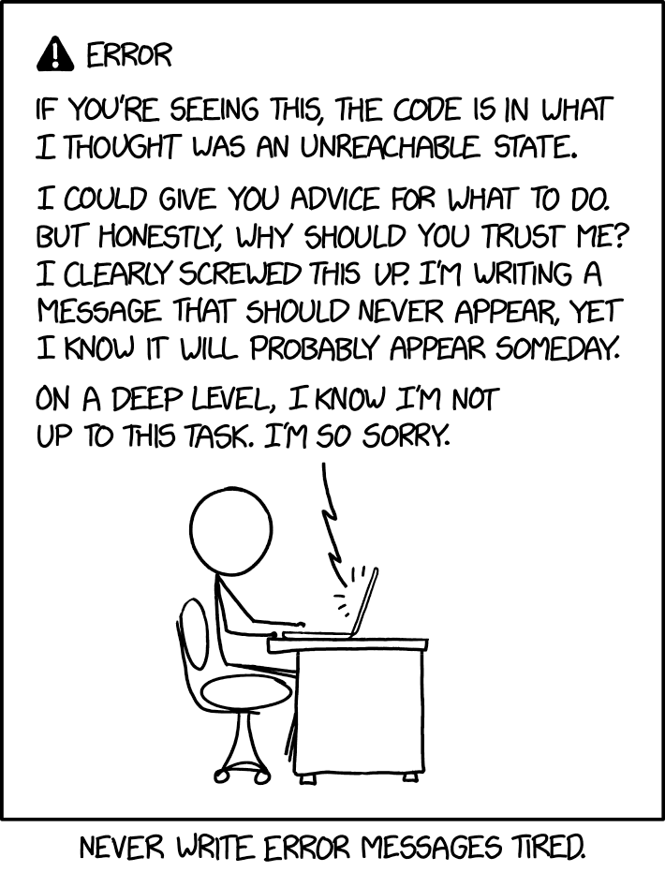
Ticket Grand Finale // the TL;DR
A “TL;DR” is a summary of all the pertinent details of the whole ticket
TL;DR == “Too Long; Didn’t Read” in Internet Slang (e.g. more fun name for “Executive Summary”)
TL;DR should be notionally the last comment on the ticket
Only thing that should be after it is a “verification” comment
TL;DR is useful for;
Communicating quickly and effectively with low-engagement audiences
Writing Engineering Software Version Description documents (ESVDs)
Technical archaeology
An engineer revisiting the ticket in the future
The engineer could be you - Make life easier for your future self!
Value for every audience
Technical Product Owner (TPO) // Managing Product Owner (MPO)
Technical Authority (TA) // Project Manager (PM)
Hardware Engineer // Software Engineer // Downstream Tester
Primary ticket contributor or project lead writes the TL;DR
(exactly when/how in the workflow this is done is covered later in the deck)

Slide 20

Anatomy of a Solid TL;DR
TL;DR should consist of an appropriate subset of;
“TL;DR: ”
A recap of the original issue observed
Any findings that altered the trajectory of the work done on the ticket
Notes on key decisions made and reasoning
Summary of the changes made to code or documents
Explicit statement that no code/doc/hardware changes were made, if applicable
Summary of any new behavior/features/changes
References to any splinter tickets created as a result, and reasoning
In the case of a rejection, the reason the ticket was rejected
For product-code-affecting tickets, if the title of the ticket is not self-explanatory then consider adding a one-liner title to be included in the PSRN
e.g. “PSRN: Improved customer experience of signal bar reporting”
TL;DR is added when ticket transitions to either;
“Normal Path” => Status: READY (Resolution: Unresolved)
“Reject Path” => Status: COMPLETE (Resolution: Rejected)
(more about states and transitions in the Ticket Workflow section of this training)

Slide 21
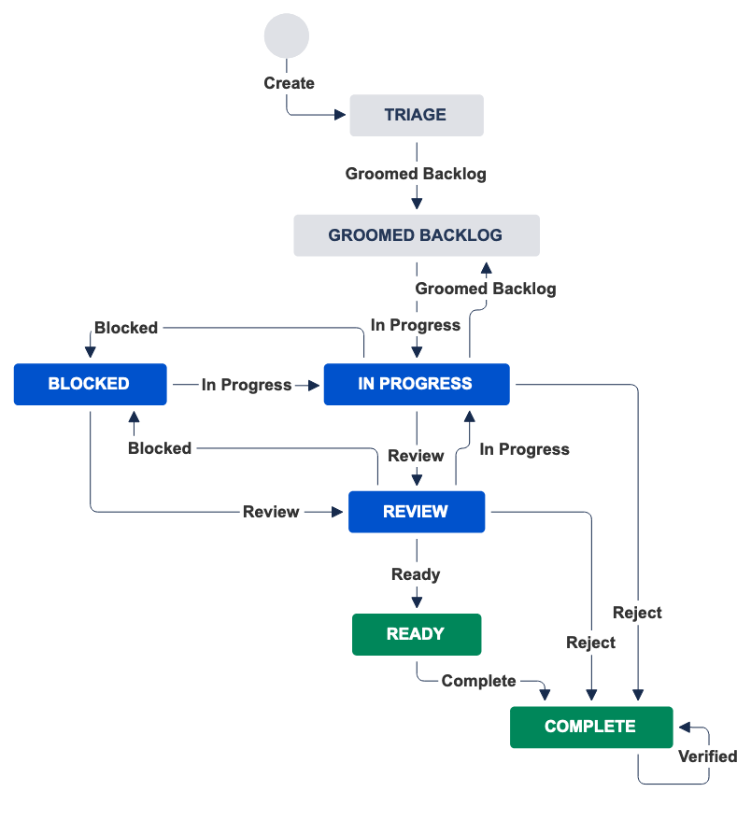
Ticket Workflow (1/4)
Ticket created in TRIAGE state
Transitioned to GROOMED BACKLOG state once ticket has been triaged/prioritized in Backlog Grooming meeting
When someone becomes available to work a ticket they will “grab from the top of the backlog”, assign the ticket to themselves, and set to IN PROGRESS
IN PROGRESS, BLOCKED and REVIEW are the main activity states in the workflow
Ticket may transition between states more than once
IN PROGRESS ⇨ REVIEW ⇨ IN PROGRESS
IN PROGRESS ⇨ BLOCKED ⇨ IN PROGRESS
Tool prevents IN PROGRESS ⇨ BLOCKED ⇨ REVIEW
BLOCKED state is used for work that is blocked by entity outside of the nominal direct-reporting team
e.g. waiting on information from 3rd party
REVIEW state where independent peer review occurs
e.g. Not the “change author”

Slide 22
Ticket Workflow (2/4)
Once independent review is completed reviewer;
Adds comments to effect of outcome of review (positive or negative)
If review positive AND software-related then the reviewer also merges changes to trunk
Assigns back to major contributor
REVIEW to READY transition is made by the major contributor of the ticket
Importantly, they also add the TL;DR as a part of this activity
Ticket is then “unassigned” after it is covered in a standup/status meeting (more on this in a few slides)

Slide 23
Ticket Workflow (3/4)
READY to COMPLETE transition depends on nature of work completed
Work that affects software/hardware/documentation
Ticket hangs in READY state until product build is produced and ESVD / change note / etc is written
Work that does not affect product
e.g. an “Investigate ...” ticket
Transitions immediately to COMPLETE
For consistency READY to COMPLETE transition carried out by Team Lead no matter if it is artifact (software/hardware/documentation) affecting or not
Team Lead can apply appropriate “fix version” at this stage and deal with transition to COMPLETE as appropriate

Slide 24
Ticket Workflow (4/4)
Verified transition used in downstream domains (outside of product engineering) to fully close off the ticket
Status: COMPLETE [Resolution: DONE] ⇨ Status: COMPLETE [Resolution: VERIFIED]
There are 2 reject paths
IN PROGRESS ⇨ COMPLETE [Resolution: REJECTED]
REVIEW ⇨ COMPLETE [Resolution: REJECTED]
Workflow enforces requirement that a comment be added for reject transitions

Slide 25
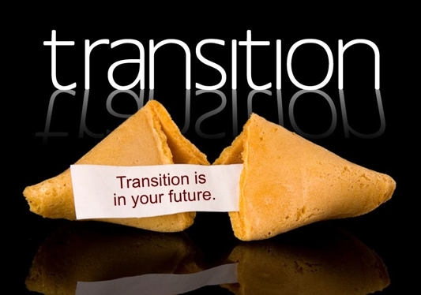
Closing Tickets // Transitioning
Transitioning a ticket to READY or REJECT
Leave assigned to yourself until you have discussed with project lead 1:1 or with the team at a stand-up
After discussing the ticket, “Unassign” the ticket from yourself so it does not muddy up the Kanban board
Note: Previous versions of this process specified that tickets related to code, hardware, or doc changes should be assigned to the product lead after being discussed in a standup. We’ve changed from that as it was causing the lead’s swim-lane to get muddied up with a mix of things they did vs things the broader team did.
At the end of the sprint the project lead will manage the creation of the release artifact(s) and clear the items from the READY and COMPLETE columns on the board
If you ever get lost / need process advice
Assign the ticket to the project lead and they will sort it out for you (and/or coach you through it)

Slide 26
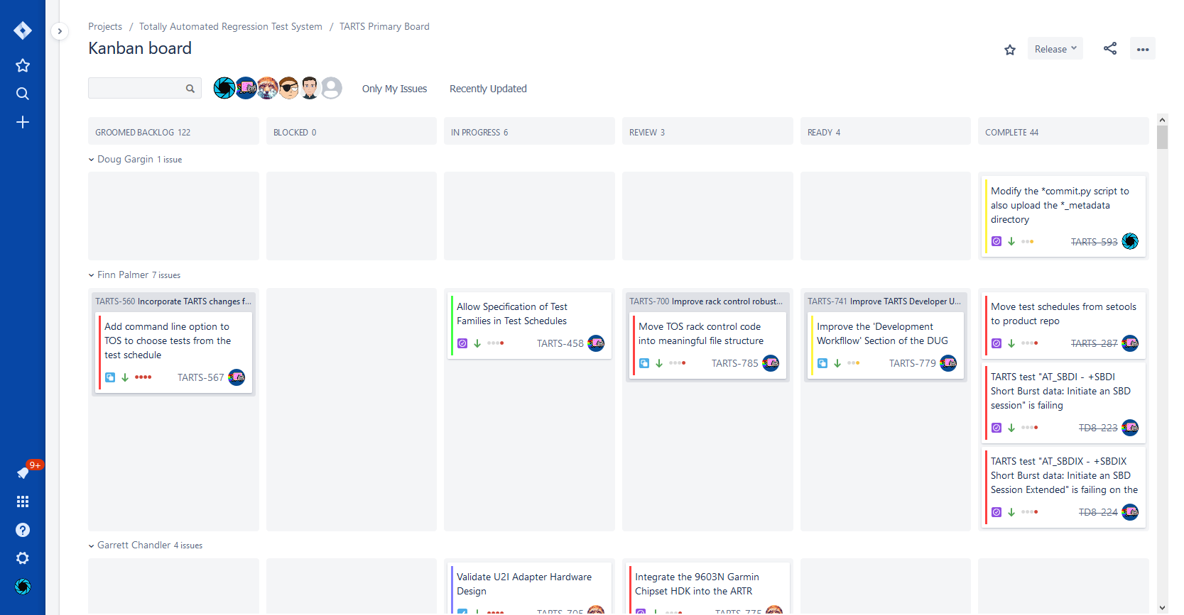

The Kanban Board
Jira Kanban board is used at minimum in all stand-ups and/or status meetings
Also immensely valuable 20k foot view for //anyone// at //anytime//
Team members should focus attention from right to left
Value is released from the right-hand-side of the board
Review tickets before working tickets
Tickets may be cherry-picked in from other projects if necessary using Kanban filter (e.g. using labels)
Kanban board ticket colors based on elapsed time since last update, e.g.:
Green <= 2 days
Yellow <= 5 days
Red <= 8 days
Purple <= 14 days
Pink <= 28 days
White > 28 days
These are intended as a helpful reminder about when it might be beneficial to turn your attention to a ticket - if you are 100% on a project it is a community norm to keep tickets green when IN PROGRESS or REVIEW. Anything beyond red indicates in general things are dragging / value is not being created at an acceptable pace.
Tickets in TRIAGE state do not show on the board
Once in GROOMED BACKLOG these will become visible
Once READY and COMPLETE tickets are discussed in stand-ups these get unassigned to keep board cleaner (no longer in upper swimlanes)
Avoids repeat updates for tasks that are complete
Features/fixes staged for next release settle in “READY Unassigned”

Slide 27
Our Journey to Enlightenment
(/) Raising Tickets (2)
(/) Ticket Summary Field (2)
(/) Ticket Description Field (2)
(/) Ticket “Definition of Done” (5)
(/) Comment Threads (3)
(/) TL;DRs (2)
(/) Ticket Workflow (5)
(/) Kanban Board (1)
(!) Backlogs (5)
(?) Team Leads (1) [optional]
(?) Software Specific (3) [optional]
(!) Ticket Miscellany (2)

Slide 28
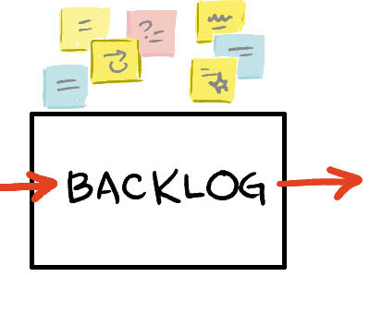
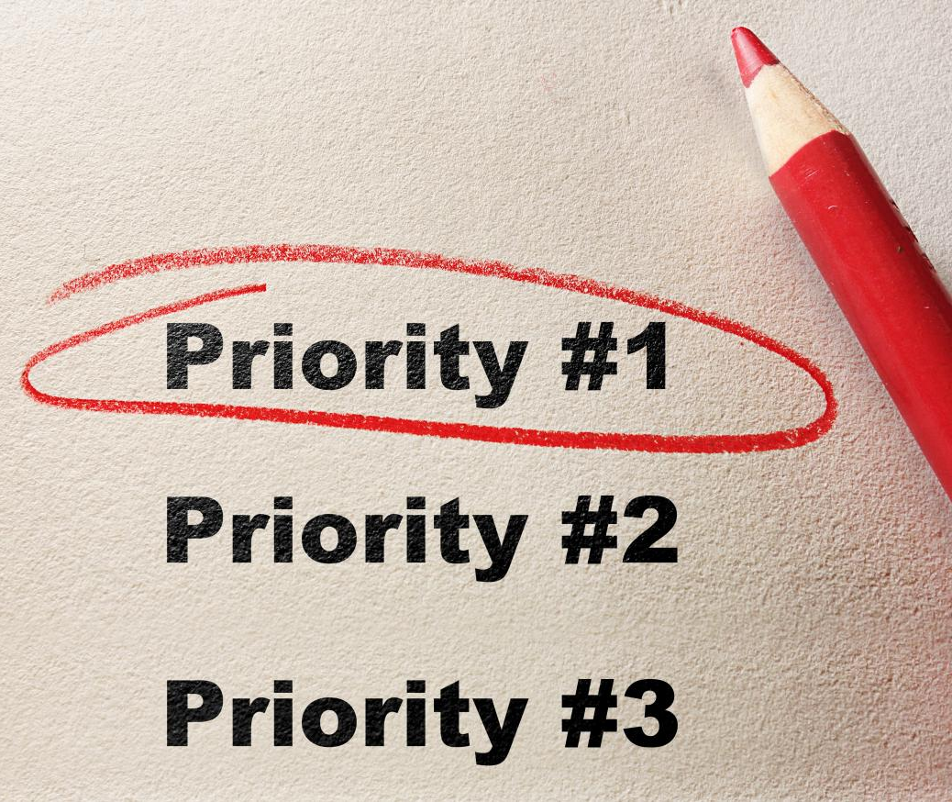
Priority Focus // The Backlog
The core of this task management strategy is pursuit of creating “continuous flow”
When a team member finishes something they need to know what should be worked on next – e.g. a “prioritized backlog of work”
A backlog of work that is been prioritized is called a Groomed Backlog
A groomed backlog has the most important thing at the top, followed by the second most important, the third, …
Notably, the concept of High/Med/Low priority tags is philosophically incongruent with a groomed backlog
These low-fidelity labels do not provide enough information to the team about what should be worked on next
If present on a ticket in a “continuous flow” project they can create confusion – e.g. why is this HIGH priority ticket below these 5 other LOW priority tasks?
In short, they are duplication of information and violate the DRY (Don’t Repeat Yourself) principle and create conflict
In summary: Priority tags should not be used (and if a ticket is found to have one it is highly recommended that the team lead dutifully remove/reset them)

Slide 29
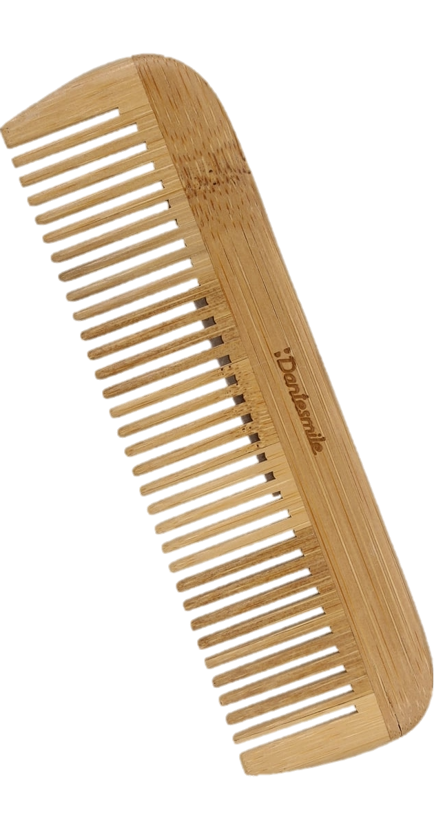
Grooming the Backlog
Backlog Grooming sessions should be conducted //on a cadence// and with all key stakeholders involved
Could be done every couple of weeks in a separate meeting
Could be during every weekly stand-up IFF all stakeholders are always there //and// it does not disrupt the flow of the stand-up (generally not recommended)
Could be done solo by project lead if they are the only key stakeholder
A Backlog Grooming meeting agenda should be approximately;
Quick update on status of tickets no-longer-on-backlog (gets the context set appropriately)
Call for “unfiled tickets” so placeholders can be created and groomed
Discuss new tickets raised since last Backlog Grooming Session (e.g. "triage")
Groom in the new tickets / yet-unfiled-placeholders
Step back to see if any previously-groomed tickets need to be repositioned
There are some tried-and-true tricks for creating a groomed backlog out of “just a pile of stuff” that make the transition to a backlog-driven team a low-burden task
See Garrett Chandler for a tutorial on how to do this if interested

Slide 30


Triage and Backlog Etiquette
Items in TRIAGE and GROOMED BACKLOG //generally// should not be assigned to anyone
Intent / philosophy is that “these are the priorities” and should not be gated by availability of an individual
Also, no work should be done related to a ticket that is not IN PROGRESS (comments are red flag of this)
Basically only shoring-up / fleshing-out of the Definition of Done should happen in this state
However, there are two real use-cases for assignment in backlog
“Ticket needs input from an individual before it can be groomed and/or to flesh out the Description / Definition of Done”
This is just about the only time comments on the ticket while in GROOMED BACKLOG are acceptable
“There is really only one person who can do this task”
Jira does good job of “have your cake and eat it too” for this
In the Backlog view anyone can see the ticket priority relative to each other
In the Kanban board (with swim lanes) anyone can see the “personal backlogs” in the Backlog column
It is up to the project lead to guide the team in walking this tightrope
At the end of the day teams are also a community – with communal expectations and norms

Slide 31
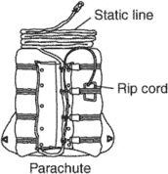
In Case of Fire Break Glass: Skipping the Backlog (1/2)
Reasoning
There are a very small handful of known/agreed instances (precisely 4) where action on new ticket (Triage state) is allowed without a backlog grooming session
These can be slippery slopes and should be used with care
If more than 5% of tickets are pulling this rip cord: re-evaluate your project/process
Product Support Tickets ([PS])
Requests from customers should be actioned attentively (only good customers😉)
Product Owner granted the power (community norms – not tool restrictions) to prefix ticket Summary with “[PS]” (abbreviation of “Product Support”)
The [PS] prefix indicates to Technical Lead et al that this ticket should automatically go to the top of the backlog and worked with priority
Tickets annotated as [PS] inherently follow the “investigate” half of the investigate/action pattern
If not written as such when they are created the Technical Lead should re-title/re-write (and scope the DOD) as an “investigation ticket”
The last item in the DOD will naturally be “create a ticket to make a change if one is decided to be necessary”
Note: “Customer” is intentionally ambiguous here – could be external customer or internal customer (GW Ops, SI&T, etc)

Slide 32

In Case of Fire Break Glass: Skipping the Backlog (2/2)
Striking While the Iron is Hot ([MERGE])
On occasion a change made for one transceiver product is relevant to one or more other products – e.g. a change that can deliver immediate value to other products via a “merge” of that change to other codebases
Project leads identify these and create [MERGE] tickets for each other
If the work for the [MERGE] ticket is considered to be small t-shirt sized (typically the case) the ticket goes to the top of the relevant product backlogs without review
Rationale is that when the merge is done close to when the original work was carried out loss of knowledge/context over time is minimized (and assists to keep us sane by not forcing us to remember a change was made to one product not another)
[MERGE] tickets should remain a lower priority than [PS] tickets
Priority Inheritance
Child tickets of in-progress tickets inherit the priority of their parent and therefore warrant also becoming immediately in-progress
Unequivocally Unanimous Decision via Crystal Ball
There will be instances where a critical issue is discovered (e.g. “product catches fire”)
In this case, it is reasonable that if a backlog grooming meeting was actually held it would be a unanimous decision to take to top of backlog
Any of the leads can prioritize this themselves without an all-stakeholders meeting

Slide 33
Purging the Board
Use Jira fix versions and “release” them to purge the board
Two types of fix version
RELCAN/DEVSNAP
E.g. DB20001, ROC-200420W-11556-I1-HB-RHUTWE0-24-DEVSNAP
Sprint/timed
E.g. PIE2001S02, Y20W24
All READY items get a sprint/timed fix version
Tickets that affect product code get RELCAN/DEVSNAP fix versions
…and the sprint/timed fix version
Release RELCAN/DEVSNAP version when delivering
Release sprint/timed versions at end of sprint/cadence
Sprint/timed versions useful for archaeology
What did we do and when?

Slide 34
Working an Issue as an Individual Contributor
Ticket ownership – **you** own the issue
Identify and seek-out the stakeholders
Ask questions
Understand the context
Think about the wider impacts of issues and changes
Present / record your recommendation and reasoning in the Jira thread
Search for any duplicates and link them to the issue

Slide 35
Straightest Path to Awesome is … Branching
All work is carried out on feature branches
Feature branches stored per product
/branches/<product>
E.g. /branches/9523_DB
Feature branches named <jira ticket>_<description>
<jira_ticket> is the Jira ticket ID, e.g. TD8-207
<description> is a human-readable short description, bcch_type_ii_ptt
Example
/branches/9523_DB/TD8-207_bcch_type_ii_ptt

Slide 36
Quality Assurance == Peer Reviews for the Win
Tickets are cross-reviewed
Reviewed by other team members and/or SME
Reviewer performs merge
Include Jira ticket number in the merge commit comment, e.g.
TD8-152: Improve beam selection in PTT with NEXT beam configuration
Branch is reviewed, merged then deleted
Jira comment added to document versions involved:
Reviewed IRDM://<feature branch> rAAAAA.
Merged to IRDM://<main branch> rBBBBB.
Deleted branch IRDM://<feature branch> rCCCCC.
For example:
Reviewed IRDM://talladega2/branches/sbd6/TD2-277_osc_warp_protection r5397
Merged to IRDM://talladega2/trunk/sbd6 r5404
Deleted branch IRDM://talladega2/branches/sbd6/TD2-277_osc_warp_protection r5405
Reviewer should also search for and link duplicates
Second perspective on duplicate tickets
Re-assign ticket to main contributor for transition to READY including TL;DR

Slide 37


Miscellaneous Topic: Sub-Issues
Jira framework supports sub-issues
Useful for tracking features/work with multiple parts (and/or multiple owners)
Top-level ticket describes main feature
Sub-issues detail portions of the task
May be able to carry out the sub-issues in parallel
Use Sub-Issues if and only if;
Activity is “worthy of it’s own Definition of Done”
Multiple strands to be worked in parallel by multiple people

Slide 38
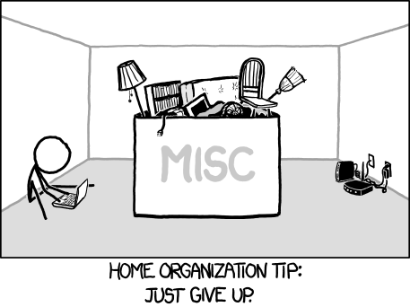
Closing with Confidence // Ticket Miscellany
A healthy ticket should have 5 to 20 comments when course run (95% of the time)
If less than 5 the task scope might not have been big enough
If more than 20 the task scope might have been too big – should have been broken into smaller tickets (a ticket this long becomes //impossible// to read)
Avoiding the JIRA ticket “CLONING” feature is highly encouraged
There are typically a non-trivial number of things you need to “reset” - and remember to add
Has been shown to cause more wasted time and effort in the resulting confusion (and lost tickets actually – as user permissions have to be set too) than the convenience value it is supposed to create
Among many other things, if a ticket //does// get CLONED be sure to remove the “CLONE - “ that JIRA prepends to the ticket summary – it’s just ust useless noise
Some project databases have work that is funded from multiple sources
Project Lead puts a label on the ticket when in the backlog
Individual Contributors charge their time to the project indicated on the ticket
Use Ticket Links!
No doubt you are going to need to “find” a ticket you know exists – but your search is going to lead you to a related ticket. Do yourself (and everyone else) a favor and use JIRA ticket links to tie them together.
Tickets are cheap: File new one if there is any chance something new isn’t related to current ticket
Hard to separate the colors of dirt once the water is muddied by more than one

Slide 39

Recap and Open Q/A
(/) Raising Tickets (2)
(/) Ticket Summary Field (2)
(/) Ticket Description Field (2)
(/) Ticket “Definition of Done” (5)
(/) Comment Threads (3)
(/) TL;DRs (2)
(/) Ticket Workflow (5)
(/) Kanban Board (1)
(/) Backlogs (5)
(x) Team Leads (1) [optional]
(x) Software Specific (3) [optional]
(/) Ticket Miscellany (2)

Slide 41
Change History
v1.0 - 14 SEP 2020 - Garrett Chandler
Forked from IRDM-0910-SD-001 'Iridium Mobile Product Software Change Process Blueprint’
v1.3 - 02 APR 2021 - Garrett Chandler
Moved to new corporate template and minor updates
Fully expect v1.1 and v1.2 were both also minor updates too
v1.4 - 27 APR 2021 - Garrett Chandler
Updates during/after training session conducted this month
Clarified the “title” and “description” JIRA terminology
Added details about how to assign DoD items to individuals and/or groups
Added info about the Product Support [PS] markup
v1.5 - 19 NOV 2021 - Garrett Chandler
Minor tweaks for clarification with fresh eyes before/during next major training cohort
Documentation of process related to [PS] and [MERGE] ticket prefixes

Slide 42
Change History
v1.6 - 03 DEC 2021 - Garrett Chandler
Minor tweaks as observed during Raj’s first cohort
v1.7 - 26 SEP 2022 - Garrett Chandler
Minor tweaks coming out of the session with the most recent cohort

